Slide 2
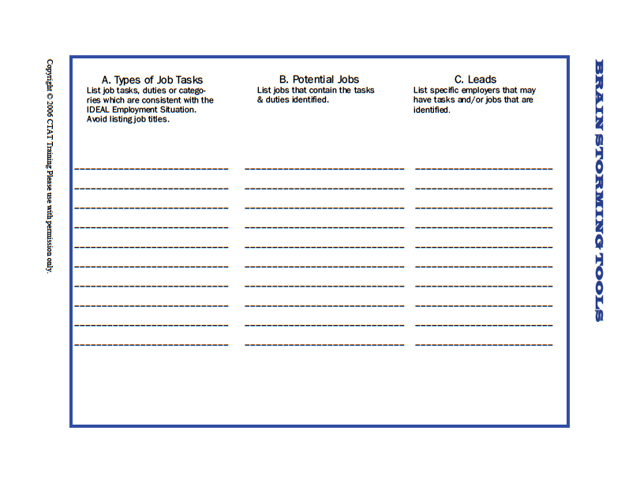

Slide 3
What Works, What Doesn’t Work
Use this brain storming tool to explore any idea related to jobs, tasks, supervision, transportation, etc. On a flipchart or piece of paper record “what works” on one half of the paper and “what doesn’t work” on the other half. The best way to use this tool is by coming up with a strategy that DOES WORK for each one that doesn’t. This technique is especially effective to get people to think positively about possibilities and solve problems.
What Works | What Doesn’t Work

Slide 4
Possible Accommodations Needed:________________________________________ __________________________________________________________________________________________________________________________________________
Advantages of Disclosure | Disadvantages of Disclosure

Slide 5
Resources
Employment and Self-Employment
The Division of Vocational Rehabilitation (877) 243-2823
Local Mental Health Agency with an Employment Program
(Aurora Mental Health Center, Community Reach Center, Jefferson Center for Mental Health, Mental Health Center of Denver, ALLHealth Network, etc.)
Small Business Development Centers (Denver, Aurora, Westminster, Boulder, etc.)
SCORE www.score.org - small business start up mentors and workshops
Education
Educational Opportunity Centers (CCD, CSU, Greeley, Adams County)
College Disability Services or Accessibility Services at Community Colleges and Universities
Volunteering
Metro Volunteers (303)282-1234

