Slide 1
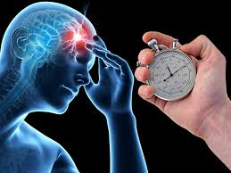
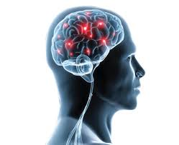
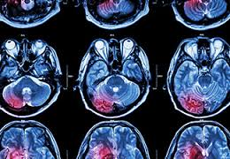
STROKE AWARENESS:
DID YOU KNOW?
An ischemic stroke occurs when a clot or plaque blocks a blood vessel, cutting off blood flow to a part of the brain. Without oxygen-rich blood, brain cells die.
Most strokes are classified as ischemic.
A hemorrhagic stroke occurs when there is bleeding in the brain.
A subarachnoid hemorrhage occurs when an aneurysm, or weakened blood vessel, ruptures and causes bleeding around the brain.
Stroke patients who receive IV tPA (alteplase) within 90 minutes of symptom onset are almost 3x more likely to recover with little or no disability.
Reasons for delay in treatment of stroke include NOT using 911 and NOT recognizing speech difficulty as a sign of a stroke.
The American Stroke Association updated their guidelines to recommend the use of stent retrievers for eligible patients. While IV r-tPA (alteplase) is a drug to dissolve a clot, a stent retriever is a mechanical device used by the Neuro Interventional Team to remove the clot. Guidelines recommend using them together in eligible patients.
Someone in the United States has a stroke every 40 seconds. Every four minutes, someone dies of a stroke.
High blood pressure is the number one risk factor for causing a stroke.
Data from 2017 ASA Fact Sheet http://www.strokeassociation.org/STROKEORG/
STROKE AWARENESS MONTH

